Slide 1
Earthquake Prediction Model

Slide 2
Content 1. Introduction 2. Problem Statement 3. Solution

Slide 3
SECTION - 1 INTRODUCTION

Slide 4
Understanding Earthquake Prediction 01 Seismic Data Analysis The Earthquake Prediction Model utilizes advanced machine learning techniques to analyze seismic data, identifying patterns and trends that can indicate the likelihood of an earthquake. By harnessing the power of recurrent neural networks (RNNs) and long- and short-term memory (LSTM) networks, the model can provide early warnings to mitigate the impact of seismic events.

Slide 5
02 Importance of Early Warnings Earthquakes pose significant risks to communities, and timely warnings are crucial for minimizing damage and ensuring public safety. The introduction of machine learning into earthquake prediction offers the potential to provide more accurate and timely forecasts, ultimately saving lives and protecting infrastructure.

Slide 6
03 Advantages of Machine Learning Traditional earthquake prediction methods have limitations, but machine learning algorithms, particularly LSTM networks, excel in capturing and understanding the temporal patterns of seismic activities. This presentation will explore the potential of these technologies in revolutionizing earthquake prediction.

Slide 7
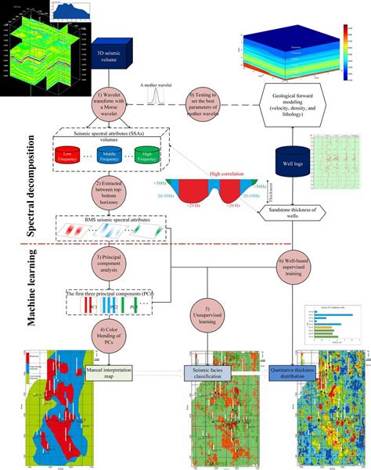
Role of Machine Learning in Seismic Analysis
01 Enhanced Data Interpretation
Machine learning algorithms, such as RNNs and LSTMs, enable the model to interpret seismic data more effectively, identifying subtle patterns and anomalies that may precede earthquakes. This allows for more nuanced and accurate predictions compared to traditional methods.
02 Real-time Monitoring
The Earthquake Prediction Model facilitates real-time monitoring of seismic activity, providing continuous analysis and early warnings to relevant authorities and communities. This proactive approach can significantly reduce the impact of earthquakes on human lives and infrastructure.
03 Potential for Global Impact
By leveraging machine learning for earthquake prediction, there is potential to create a global network of early warning systems, enhancing preparedness and response capabilities across regions prone to seismic events.

Slide 8
SECTION – 2 PROBLEM STATEMENT

Slide 9



Limitations of Traditional Methods
Challenges in Accuracy
Traditional earthquake prediction methods often struggle to provide accurate forecasts within a reasonable timeframe, leading to challenges in effectively mitigating the impact of seismic events. This section will highlight the limitations of existing approaches and the need for more advanced prediction models.
Timeliness of Warnings
The delayed nature of traditional earthquake prediction methods hinders the ability to issue timely warnings, impacting the preparedness and response capabilities of communities. The Earthquake Prediction Model aims to address these shortcomings through the integration of machine learning algorithms.
Risk to Human Lives and Infrastructure
The consequences of inaccurate or delayed earthquake predictions can be catastrophic, posing a significant risk to human lives and critical infrastructure. This presentation will emphasize the urgency of adopting more effective prediction methods to minimize these risks.

Slide 10
Data-Driven Approach 01 Harnessing Seismic Data The Earthquake Prediction Model recognizes the potential of leveraging vast amounts of seismic data to enhance prediction accuracy. By adopting a data-driven approach, the model aims to extract valuable insights from complex seismic patterns, enabling more precise forecasts and early warnings. 02 Machine Learning Advantages This section will explore the inherent advantages of employing machine learning algorithms, particularly RNNs and LSTMs, in seismic data analysis. The ability to detect subtle temporal patterns and anomalies equips the model with a powerful tool for earthquake prediction.

Slide 11
SECTION – 3 SOLUTION

Slide 12
RNN and LSTM Networks
The Earthquake Prediction Model integrates recurrent neural networks (RNNs) and long- and short-term memory (LSTM) networks to harness the power of machine learning in seismic data analysis. This section will delve into the specific functionalities of these networks and their role in enhancing prediction accuracy.

Slide 13
THANK YOU

